Slide 1
P2P File Transfer
Group 6:
Ta Hoang Hai Nam
Le Sinh Quy
Trinh Hoang Hai
Kieu Quoc Viet

Slide 2
Table Of Contents
1. What
2. Why
3. Architecture
4. Code Implement
5. Conclusion

Slide 3
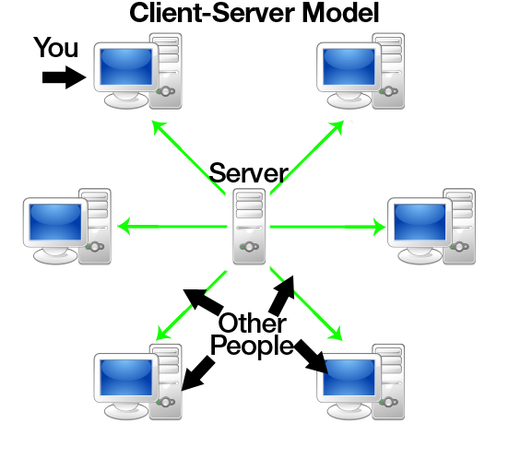
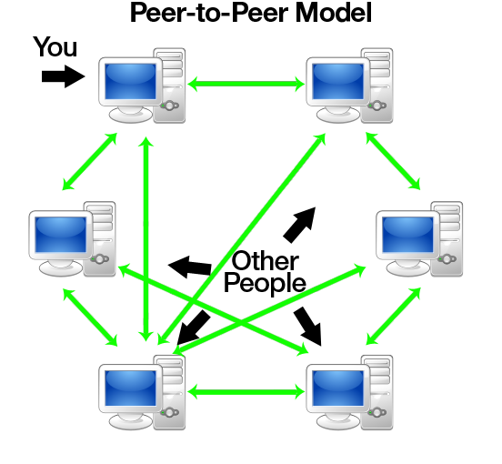
1. What

Slide 4



2. Why
Difficult to take down
Scalable
Faster for sharing
Application:

Slide 5
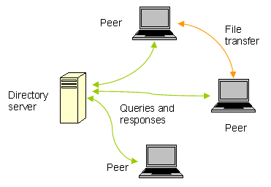
3. Architecture
P2P: centralized directory
Benefits:
High success rate
Fault Tolerant
Drawbacks:
Central point of failure
Limited scale
Security

Slide 6
4. Code Implement
Compile steps
> gcc -o server server.c –pthread
> ./server [server-port-number]
> gcc –o peer peer.c –pthread
> cd peer-x ( any peer folder)
> ./peer [server-hostname][server-port-number][peer-port-number]

Slide 7
5. Conclusion
Who does what?
Slide: Le Sinh Quy, Trinh Hoang Hai and Kieu Quoc Viet
Code Implement: Ta Hoang Hai Nam

